Slide 1
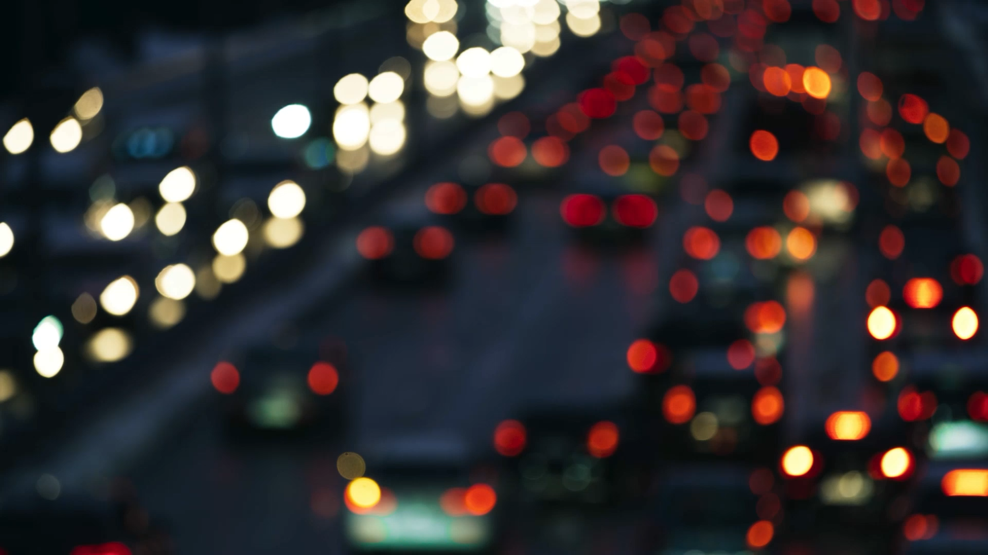
SUMO-Based Intelligent Traffic Lights Control System for Congested Areas in Colombo
M23W0628 – N.W.V.C.K.Chathuranga

Slide 2

What is Intelligent Traffic Lights Control System
The Intelligent Traffic Lights Control System can automatically adjust traffic signal timings based on current traffic conditions.
This system enhances traffic flow efficiency, reduces congestion, and minimizes waiting times for both vehicles and pedestrians, ultimately contributing to safer and more organized roadways.

Slide 3
What is SUMO
SUMO stands for the Simulation of Urban Mobility.
This simulation application is designed to create simulated roadways that incorporate traffic control systems.
Models traffic scenarios with pedestrian and public transport interactions.
Integrates real-world data for accurate urban mobility simulations.

Slide 4
Reasons for Traffic Congestion in the Colombo Area
High Population Density
Limited Road Infrastructure
Public Transport Challenges
Traffic Management Issues
Road Construction and Maintenance

Slide 5
Traffic Management Issues
High Volume of Vehicle Density
Poor Traffic Light Time Management System
Inadequate Road Infrastructure Leading to Frequent Congestion
Lack of Real-Time Traffic Updates for Commuters
Increased Vehicle Usage

Slide 6
Why Poor Traffic Light Management System?
Sri Lanka still uses a fixed-time traffic light control system in most areas of Colombo.
When traffic congestion is high, it will be managed manually by police officers.

Slide 7
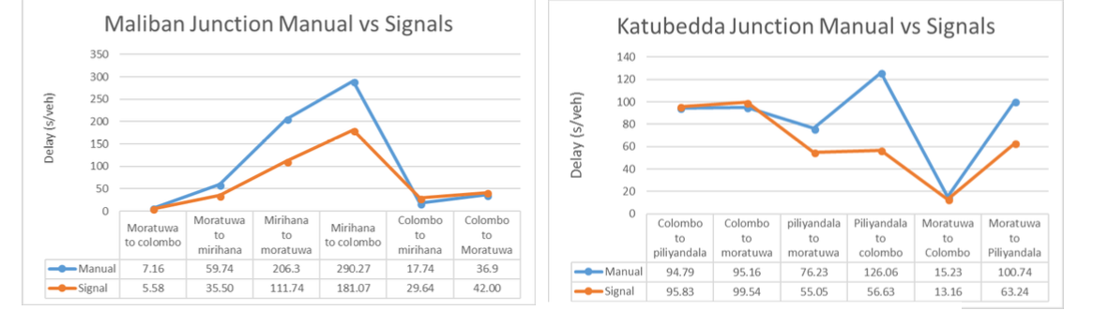
Result

Slide 8
What solutions do researchers recommend, and why have they failed?
Signal Coordinate Approach- Traffic signal coordination improves flow on busy roads but has drawbacks like community impact and maintenance costs. Traffic growth and incidents can limit its effectiveness.
Traffic Queue Length Approach - The proposed system uses an array of sensors for accurate queue length estimation, as a single sensor is insufficient. Sensor placement varies based on traffic direction, vehicle types, and peak hours. However, this method is not cost-effective and is difficult to install on roadways.

Slide 9
Proposing a New Approach
Reinforcement Learning Approach – Reinforcement Learning is a machine learning method where an agent learns from interacting with an environment, receiving rewards or penalties for its actions. It aims to maximize long-term rewards and is applied in areas like robotics and gaming.
Why use Reinforcement Learning Approach - The reinforcement learning (RL) approach aims to reduce delays, congestion, and travel times while enhancing safety and traffic flow. It improves coordination among traffic signal controllers, enabling systems to adapt to changing conditions. Using data-driven methods, RL employs negative reinforcement to deter congestion and positive reinforcement to promote smooth traffic. This results in more intelligent and flexible urban transportation networks.
What are the algorithms used,
Q – Learning
Deep Q - Network
Multi-Agent Reinforcement Learning

Slide 10
What the Q-Learning Approach
State – Action- Reward Framework - Employs a trial-and-error method to discover the best actions for making decisions by enhancing total rewards.
Suitable for Traffic Systems - Manages intricate and changing settings such as traffic systems by developing strategies to minimize congestion and enhance flow.

Slide 11
Why Q - Learning
Scalability - Simple to implement across various traffic signals with different configurations.
Flexibility - Able to adjust to immediate alterations in traffic conditions without any preset guidelines.
Optimization - Strives to reduce wait times and enhance effectiveness, which is essential for intelligent traffic management.

Slide 12
What is the Deep-Q Network
Integration of Neural Network with Q-Learning – Substitutes Q-tables with neural networks to estimate Q-values, allowing for decision-making in extensive state-action spaces.
Experience Replay and Target Networks - Improves learning stability by storing past experiences and using separate networks for stable Q-value updates.
Scalability for Complex Enviroment - Manages input data in high dimensions, making it ideal for extensive and changing systems such as urban traffic networks.

Slide 13
Why Deep-Q Network
Handle Large Map Area – Able to effectively manage the complexities of large-scale traffic systems.
Real-Time Optimization – Develops adaptive policies that adjust to real-time traffic conditions.
Enhanced Performance - Achieves better coordination and efficiency compared to traditional Q-learning.

Slide 14
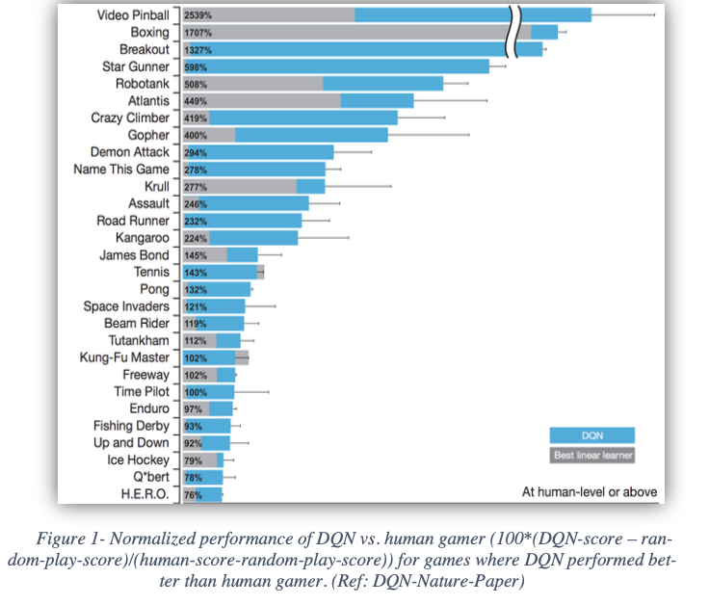
Deep-Q Network vs Human

Slide 15
What is the Multi-Agent Reinforcement Learning (MARL)
Multiple Learning Agents - MARL is a dynamic process where multiple agents learn and collaborate in a shared environment, driving towards both personal aspirations and collective success.
01
Collaboration and Competition - Agents may cooperate to optimize shared rewards or compete to maximize individual gains, depending on the task.
02
Dynamic Environments - appropriate for intricate, evolving systems such as traffic control, where agents need to adjust to shifting situations.
03

Slide 16
What & Why Centralized MARL
Global Perspective - Agents actively learn and make independent decisions, leveraging local insights instead of relying on a broader view.
Higher Coordination - Each agent functions autonomously, making it more scalable, which is perfect for extensive systems such as urban traffic networks.
Challenges - Collaboration between agents can be challenging, which might result in less than ideal results.

Slide 17
What & Why Decentralized MARL
Independent Decision Making - Agents operate independently and make decisions based on their local observations, allowing them to respond quickly and efficiently without needing a broader context.
Scalability and Flexibility - Each agent works on its own, making the system more scalable. This is perfect for large setups, like traffic systems in a city.
Challenges - Collaboration among agents can be challenging, which may result in less-than-ideal results.

Slide 18
SUMO Enviroment
SUMO consists of three applications.
SUMO GUI - This application is designed to facilitate simulations.
Netedit – This application allows editing maps, road networks, and various conditions on the map.
OSM Web Wizard – This application supports the generation of real-world maps using OpenStreetMap.

Slide 19
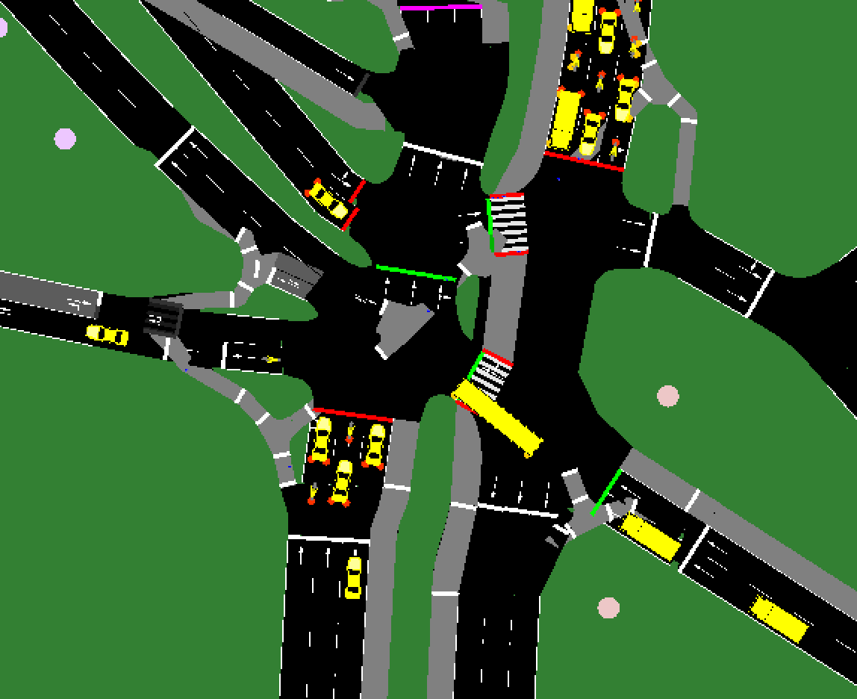
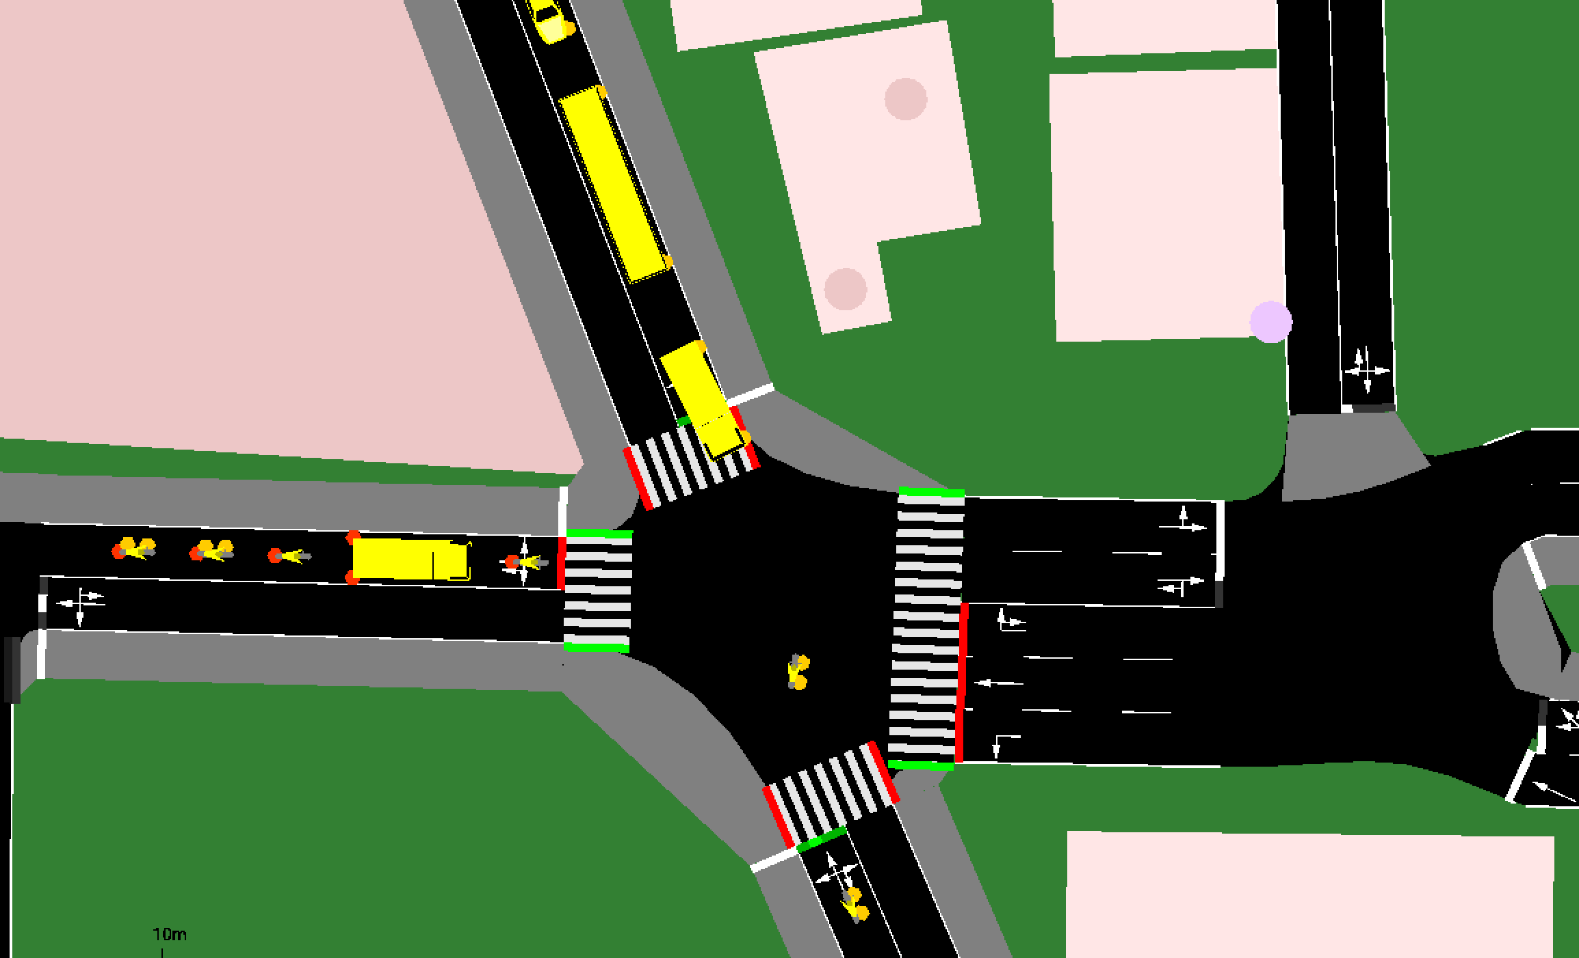

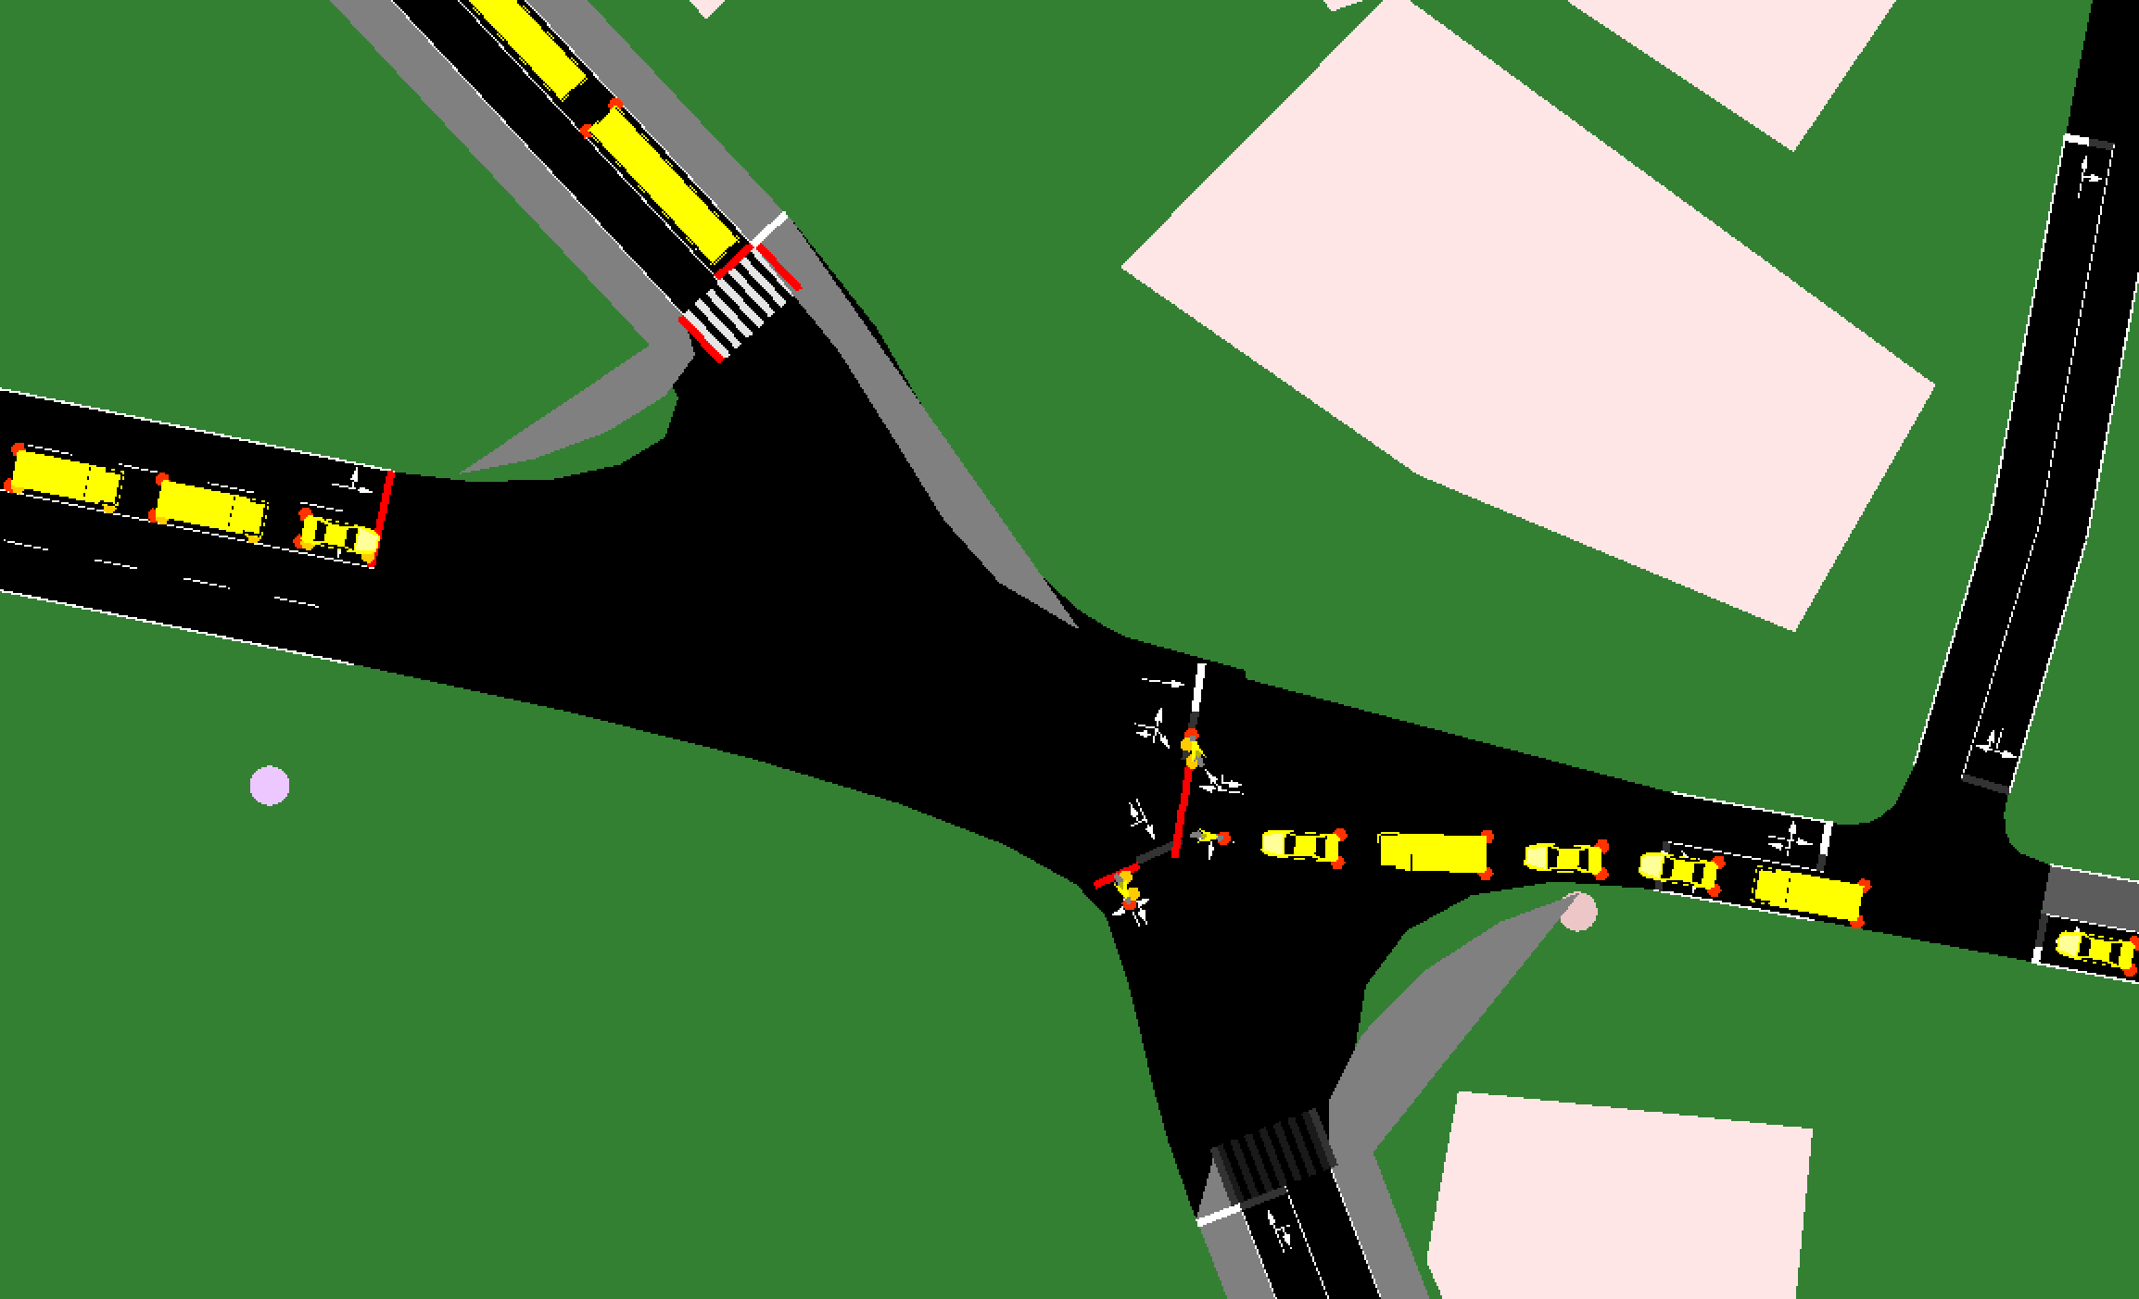
SUMO GUI
SUMO GUI supports visualizing road rules and vehicle simulations, allowing us to understand traffic flow and identify areas prone to traffic jams.

Slide 20
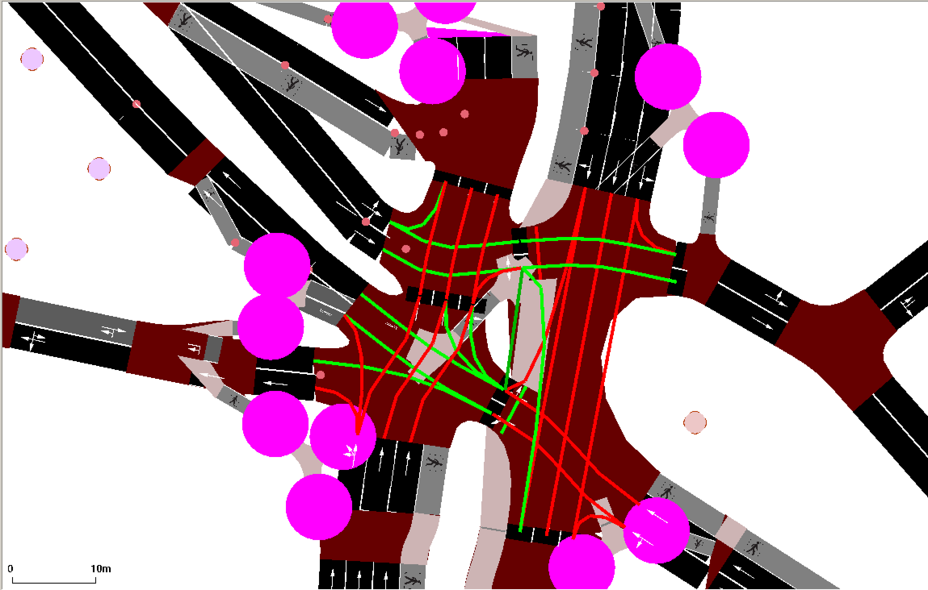
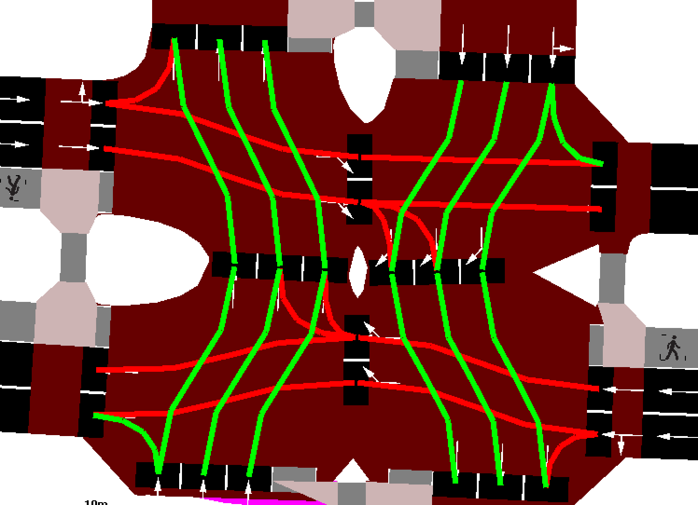
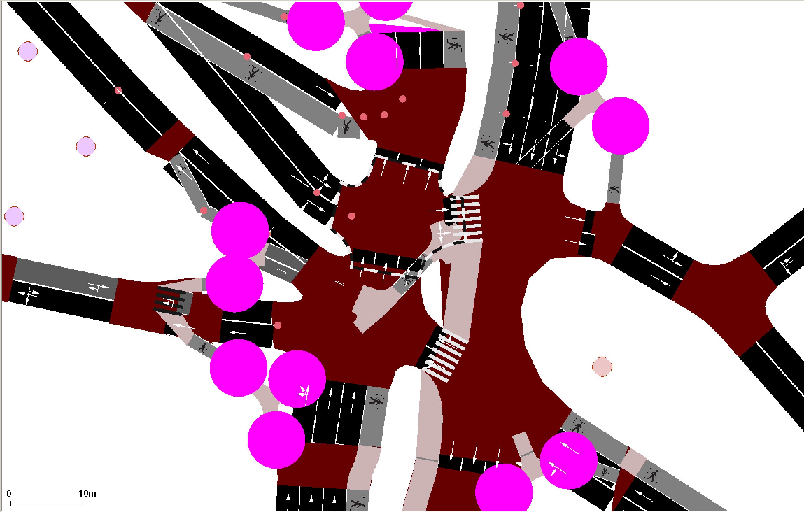
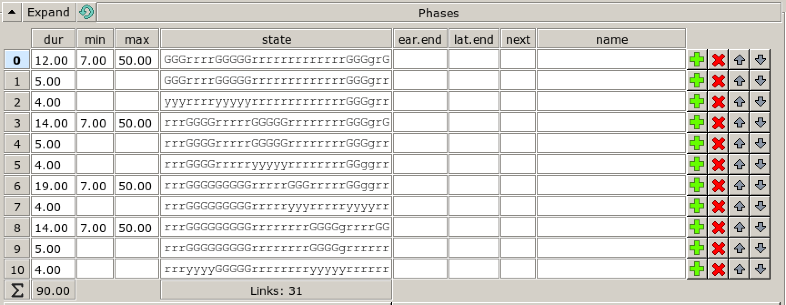
Netedit
This application allows users to edit road networks along with their associated rules and traffic light conditions.
We can efficiently manage vehicle demand on the map using this application to optimize operations.

Slide 21
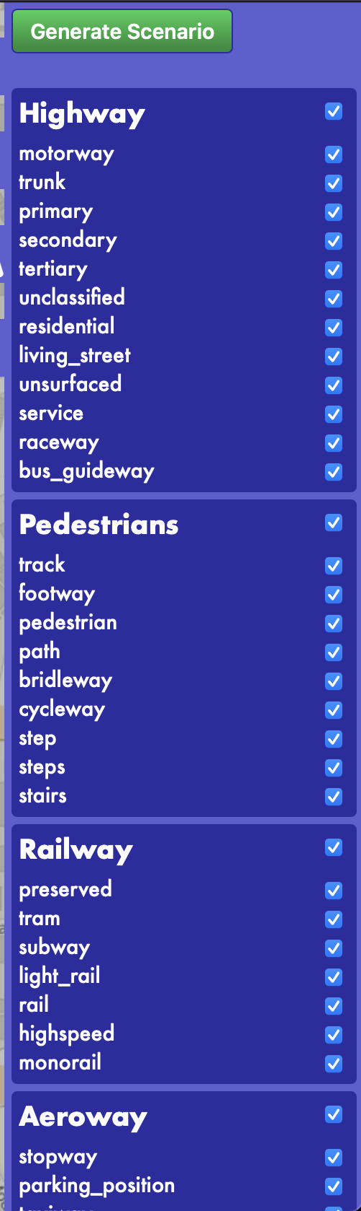
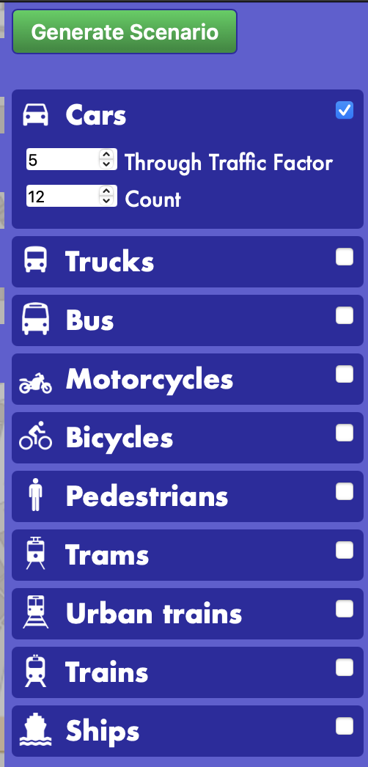
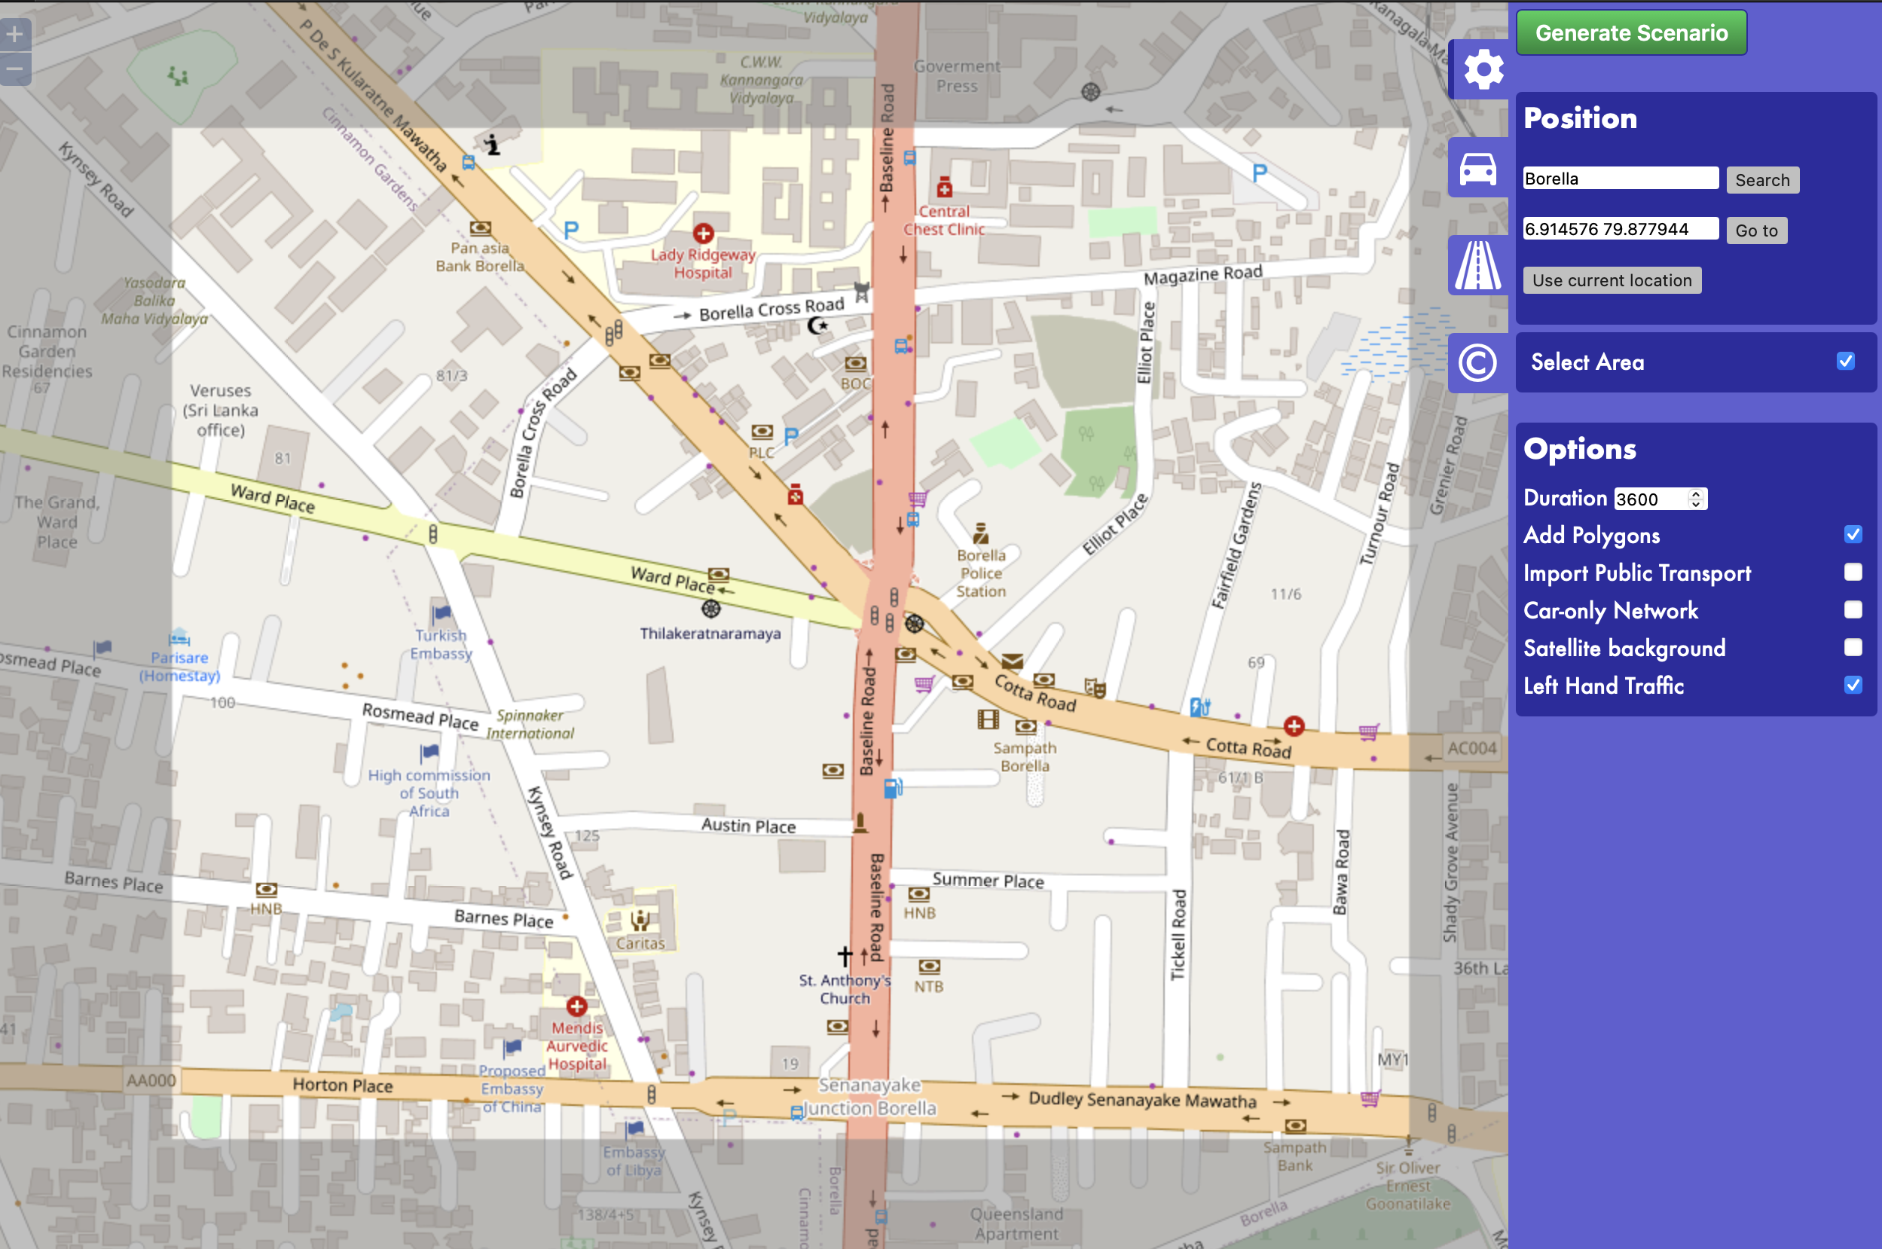
OSM Web Wizard
This application allows us to create simulated real-world maps.
Can generate the number of vehicles on the map, as well as identify their types.
We can determine which road networks we will use for the simulation.
Ex: Highways
Pedestrians Roads
Railway
Aeroway

Slide 22
Goal and Motivation
This study aims to create a reinforcement learning-based traffic management system to optimize vehicle flow and reduce congestion in the Colombo Metropolitan Area.
The Colombo Metropolitan Area is severely congested due to rapid urbanization and outdated traffic management, causing delays, higher costs, and environmental problems.

Slide 23
Training Enviroment
Chip - Apple M2
Processor – 8 Core CPU, 10 Core GPU, 16 Core Neural Network
Memory – 16GB (LPDDR5)
OS & Version – MacOS Sequoia 15.2

Slide 24
Python Enviroment and Libraries
Python – 3.10.16
TraCI – 1.21.0
Tensorflow-Macos – 2.16.2
Tensorflow-Metal – 1.1.0
Multiprocess – 0.70.17

Slide 25
Algorithm comparison
 | Q-Learning | Deep Q Network | MARL Centerlized Approach | MARL Decenterlised Approach
EC | No | No | Coordinate entire system | No direct coordination
Algorithm use | Bellman Equation | NN | NN | NN
Model | Q-table | DNN | DNN | DNN
Communication | No | No | High ( states/ actions) | Low ( status)
Action | Single Agent Action | Single Agent Action | All Agent Action | Individual Action
Robustness | Depend on Single Agent | Depend on Single Agent | Depend on Every Agent | Independent Agent
CPR | Low | Moderate | High | Moderate
EC = Environment Coordination
CPR = Computational Power Requirement
NN = Neural Network
DNN = Deep Neural Network

Slide 26
Models Training Time
Q – Learning Model – Appx: 5 Hours
Deep-Q Network Model – Appx: 5 Days
MARL Centralized Model – Appx: 2 Weeks
MARL Decentralized Model – Appx : More Than 2 Weeks

Slide 27
Implementation Parameters
Alpha- 0.01 - Learning rate, controlling the step size in the optimization process.
Gamma – 0.9 - Discount factor, determining the importance of future rewards in the learning process.
Epsilion – 1.0 - Exploration rate, initially setting the likelihood of taking random actions for exploration.
Epsilion_min – 0.01 - Minimum exploration rate, ensuring epsilon doesn’t decrease below this threshold.
Epsilion_decay – 0.995 - Rate at which epsilon decreases after each episode, promoting more exploitation over time.
Batch size – 128 - The number of experiences used to train the model in each update step.
Num_of_episodes – 100 - Total number of training episodes during which the model will learn.

Slide 28

Results

Slide 29
Results Comparision - Preformance
Factor | Simulation (Original Status) | Q-learning | Deep Q Network | MARL – Centralized | MARL – Decentralized
Duration | 266.77 | 47.64 | 46.78 | 43.89 | 41.32
Real-Time Factor | 167.012 | 172.935 | 183.492 | 194.128 | 207.645
UPS | 117244 | 119586 | 123438 | 127902 | 132154
UPS - Person | 684 | 7360 | 7895 | 8412 | 8965

Slide 30
Performance Chart

Slide 31
Performance Chart

Slide 32
Performance Chart
UPS : UNIVERSAL PERSON SET

Slide 33
Performance Chart
UPS : UNIVERSAL PERSON SET

Slide 34
Results Comparision - Vehicles
Factor | Simulation (Original Status) | Q-learning | Deep Q Network | MARL – Centralized | MARL – Decentralized
Inserted | 5992 | 6148 | 6419 | 6792 | 7051
Running | 2143 | 1497 | 1624 | 1756 | 1839
Waiting | 2108 | 974 | 798 | 612 | 428
Teleports | 8449 | 1943 | 1732 | 1484 | 1189
Emergency Braking | 5 | 3 | 1 | 1 | 0

Slide 35
Vehicles Chart

Slide 36
Vehicles Chart

Slide 37
Vehicles Chart

Slide 38
Vehicles Chart

Slide 39
Vehicles Chart

Slide 40
Results Comparision - Person
Factor | Simulation (Original Status) | Q-learning | Deep Q Network | MARL – Centralized | MARL – Decentralized
Inserted | 713 | 748 | 779 | 804 | 826
Running | 78 | 85 | 92 | 102 | 123
Jammed | 37 | 21 | 14 | 9 | 5

Slide 41
Person Chart

Slide 42
Person Chart

Slide 43
Person Chart

Slide 44
Results Comparision - Statistics
Factor | Simulation (Original Status) | Q-learning | Deep Q Network | MARL – Centralized | MARL – Decentralized
Route Length | 874.35 | 858.21 | 843.89 | 831.47 | 820.54
Speed | 0.87 | 1.48 | 1.57 | 1.68 | 1.79
Duration | 5219.81 | 1498.73 | 1439.12 | 1352.65 | 1271.98
Waiting Time | 4773.45 | 1085.47 | 974.23 | 832.91 | 721.35
Time Loss | 4946.44 | 1182.78 | 1093.63 | 973.51 | 862.17
Depart Delay | 8607.49 | 389.25 | 223.67 | 348.71 | 256.93

Slide 45
Statistics Chart

Slide 46
Statistics Chart

Slide 47
Statistics Chart

Slide 48
Statistics Chart

Slide 49
Statistics Chart

Slide 50
Statistics Chart

Slide 51
Results Comparision – Pedestrians Statistics
Factor | Simulation (Original Status) | Q-learning | Deep Q Network | MARL – Centralized | MARL – Decentralized
Route Length | 246.83 | 239.87 | 218.73 | 232.51 | 224.98
Duration | 256.23 | 199.65 | 182.94 | 165.43 | 142.67
Time Loss | 76.01 | 61.25 | 51.47 | 32.98 | 32.78

Slide 52
Pedestrians Statistics Chart

Slide 53
Pedestrians Statistics Chart

Slide 54
Pedestrians Statistics Chart

Slide 55
Discussion
Improves traffic flow and reduces delays for over a million commuters.
1
Enhances air quality and promotes sustainability by reducing emissions and oil consumption.
2

Slide 56
Limitations
Insufficient Access to Real-Time Data
Utilized Simulated Data from SUMO
Limited Availability of Data Collection Devices
High Computational Complexity
Need for Enhanced Coding Proficiency
Inadequate Research Time Available

Slide 57
Conclution
Reinforcement Learning for Traffic Light Control
Explores effective application of RL methods versus traditional fixed-time systems.
Analysis of RL Approaches
Examines Q-learning, policy gradients, and deep reinforcement learning, highlighting their unique characteristics.
Impact on Urban Mobility
Emphasizes optimization of signal timings to reduce congestion and improve traffic flow management.

Slide 58
Future Work
Assess algorithms to determine the best fit for the scenario, considering efficiency, accuracy, scalability, and ease of implementation.
Create a device to collect real-time data using video streams for vehicle counts and related information. These devices will be installed at traffic light locations.
Prepare models for retraining by selecting optimal parameters and methods to enhance performance in various situations.
High-performance computing systems are used to train the models for a clear comparison of their capabilities and efficiency.
Aim to evaluate the model’s effectiveness by simulating traffic scenarios in Colombo city. This will help us assess how well it manages urban traffic complexities and provide valuable insights into its practical application.

Slide 59
Thank You

